Slide 1
BRUTE FORCE
ALGORITHM ANALYSIS
<<professor>>
Computer Science Department

Slide 2
BRUTE FORCE
A straightforward approach, usually based directly on the problem’s statement and definitions of the concepts involved
Examples:
Computing a^{n} (a > 0, n a nonnegative integer)
Computing n!
Multiplying two matrices
Searching for a key of a given value in a list
Computer Science Department
Slide <number> of 31

Slide 3
Brute-Force Sorting Algorithm
Selection Sort Scan the array to find its smallest element and swap it with the first element. Then, starting with the second element, scan the elements to the right of it to find the smallest among them and swap it with the second elements. Generally, on pass i (0 ≤ i ≤ n-2), find the smallest element in A[i..n-1] and swap it with A[i]:
A[0] ≤ . . . ≤ A[i-1] | A[i], . . . , A[min], . . ., A[n-1]
in their final positions
Example: 7 3 2 5
Computer Science Department
Slide <number> of 31

Slide 4
ANALYSIS OF SELECTION SORT
Algorithm Selection Sort(A[0..n-1])
//Sorts a given array by selection sort
//Input: An array (A[0..n-1]) of orderable elements
//Output: Array (A[0..n-1]) sorted in ascending roder
for i ← to n-2 do
min ← i
for j ← i + 1 to n-1 do
if A[j]<A[min] min ← j
swap A[i] and A[min]
Time efficiency:
Space efficiency:
Stability:
Θ(n^2)
Θ(1), so in place
yes
Computer Science Department
Slide <number> of 31

Slide 5
BRUTE-FORCE STRING MATCHING
pattern: a string of m characters to search for
text: a (longer) string of n characters to search in
problem: find a substring in the text that matches the pattern
Computer Science Department
Slide <number> of 31

Slide 6
BRUTE FORCE STRING MATCHING
Brute-force algorithm
Step 1 Align pattern at beginning of text
Step 2 Moving from left to right, compare each character of pattern to the corresponding character in text until
    all characters are found to match (successful search); or
    a mismatch is detected
Step 3 While pattern is not found and the text is not yet exhausted, realign pattern one position to the right and repeat Step 2
Computer Science Department
Slide <number> of 31

Slide 7
EXAMPLES OF BRUTE-FORCE STRING MATCHING
Pattern: 001011 Text: 10010101101001100101111010
2. Pattern: happy Text: It is never too late to have a happy childhood.
Computer Science Department
Slide <number> of 31

Slide 8
PSEUDOCODE AND EFFICIENCY
Algorithm BruteForceStringMatch(T[0..n-1]), (P[0..m-1])
//Implements brute force string matching
//Input: An array (T[0..n-1]) of n characters representing a text and an (P[0..m-1]) of m characters representing a patter
//Output: The index of the first character in the text that starts a matching substring or -1 if the search is unsuccessul
for i ← to n-m do
j ← 0
while j<m and P[j} = T[i+j] do
j← j+1
if j=m return i
return -1
Time efficiency:
Θ(mn) comparisons (in the worst case)
Computer Science Department
Slide <number> of 31

Slide 9
BRUTE-FORCE POLYNOMIAL EVALUATION
Problem: Find the value of polynomial p(x) = a_{n}x^{n} + a_{n-1}x^{n-1} +… + a₁x¹ + a₀
at a point x = x₀
Brute-force algorithm
p ← 0.0
for i ← n downto 0 do
power ← 1
  for j ← 1 to i do //compute x^{i}
  power ← power ∗ x
  p ← p + a[i] ∗ power
  return p
Efficiency:
0in i = Θ(n^2) multiplications
Computer Science Department
Slide <number> of 31

Slide 10
POLYNOMIAL EVALUATION: IMPROVEMENT
Can do better by evaluating from right to left:
Better brute-force algorithm
Efficiency:
Horner’s Rule is another linear time method.
p  a[0]
power  1
for i  1 to n do
    power  power  x
  p  p + a[i]  power
  return p
Θ(n) multiplications
Computer Science Department
Slide <number> of 31

Slide 11
Brute-Force Strengths & Weaknesses
Strengths
  wide applicability
  simplicity
  yields reasonable algorithms for some important problems
  (e.g., matrix multiplication, sorting, searching, string matching)
  Weaknesses
  rarely yields efficient algorithms
  some brute-force algorithms are unacceptably slow
  not as constructive as some other design techniques
Computer Science Department
Slide <number> of 31

Slide 12
EXHAUSTIVE SEARCH
A brute force solution to a problem involving search for an element with a special property, usually among combinatorial objects such as permutations, combinations, or subsets of a set.
Method:
  generate a list of all potential solutions to the problem in a systematic manner evaluate potential solutions one by one, disqualifying infeasible ones and, for an optimization problem, keeping track of the best one found so far
  when search ends, announce the solution(s) found
Computer Science Department
Slide <number> of 31

Slide 13
EXAMPLE 1: TRAVELING SALESMAN PROBLEM
Given n cities with known distances between each pair, find the shortest tour that passes through all the cities exactly once before returning to the starting city
Alternatively: Find shortest Hamiltonian circuit in a weighted connected graph
Example:
2
a
b
5
3
8
4
c
d
7
How do we represent a solution (Hamiltonian circuit)?
Computer Science Department
Slide <number> of 31

Slide 14
HAMILTON CIRCUIT
A Hamilton circuit in a graph is a circuit that visits each vertex exactly once (returning to the starting vertex to complete the circuit).
Computer Science Department
Slide <number> of 31

Slide 15
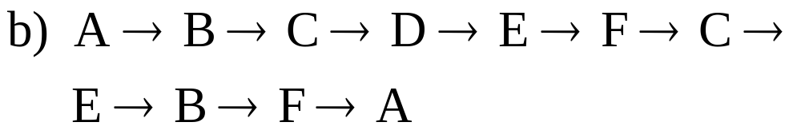
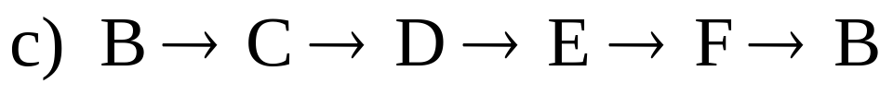
EXAMPLE: IDENTIFYING HAMILTON CIRCUITS
Refer to the graph below. Which of the following are Hamilton circuits?
B
C
D
A
F
E
Computer Science Department
Slide <number> of 31

Slide 16
Hamiltonian Circuits for
Complete Graphs
Any complete graph with three of more vertices has a Hamilton circuit.
When Hamilton Circuits Are the Same
Hamilton circuits that differ only in their starting points will be considered to be the same circuit.
Computer Science Department
Slide <number> of 31

Slide 17
NUMBER OF HAMILTON CIRCUITS IN A COMPLETE GRAPH
A complete graph with n vertices has (n – 1)! Hamilton circuits.
Example:
  How many Hamilton circuits are in a complete graph with 5 vertices?
  Here n = 5, so there are (5 – 1)! = 4! = 24 Hamilton circuits.
Computer Science Department
Slide <number> of 31

Slide 18
Nearest Neighbor Algorithm for TSP
Step 1: Choose a starting point. Call this vertex A.
Step 2: Check all the edges joined to A, and choose one that has the smallest weight. Proceed along this edge to the next vertex.
Step 3: At each vertex you reach, check the edges from there to vertices not yet visited. Choose the smallest weight. Proceed along this edge to the next vertex.
Step 4: Repeat Step 3 until you have visited all the vertices.
Step 5: Return to the starting vertex.
Computer Science Department
Slide <number> of 31

Slide 19
TSP BY EXHAUSTIVE SEARCH
Tour Cost
a→b→c→d→a 2+3+7+5 = 17
a→b→d→c→a 2+4+7+8 = 21
a→c→b→d→a 8+3+4+5 = 20
a→c→d→b→a 8+7+4+2 = 21
a→d→b→c→a 5+4+3+8 = 20
a→d→c→b→a 5+7+3+2 = 17
2
a
b
5
3
8
4
c
d
7
Computer Science Department
Slide <number> of 31

Slide 20
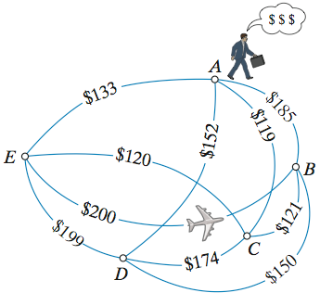
Computer Science Department
Slide <number> of 31
Notes:
ANSWER: A, D, B, C, E, A
A, E, C, B, D, A = 676

Slide 21
EXAMPLE 2: KNAPSACK PROBLEM
Given n items:
  weights: w₁ w₂ … w_{n}
  values: v₁ v₂ … v_{n}
  a knapsack of capacity W
Find most valuable subset of the items that fit into the knapsack
Example: Knapsack capacity W=16
item weight value
2 $20
5 $30
10 $50
4 5 $10
Computer Science Department
Slide <number> of 31

Slide 22
Knapsack Problem by Exhaustive Search
Subset Total weight Total value
{1} 2 $20
{2} 5 $30
{3} 10 $50
{4} 5 $10
{1,2} 7 $50
{1,3} 12 $70
{1,4} 7 $30
{2,3} 15 $80
{2,4} 10 $40
{3,4} 15 $60
{1,2,3} 17 not feasible
{1,2,4} 12 $60
{1,3,4} 17 not feasible
{2,3,4} 20 not feasible
{1,2,3,4} 22 not feasible
Efficiency:
Θ(2^n)
Each subset can be represented by a binary string
Computer Science Department
Slide <number> of 31

Slide 23
FINAL COMMENTS ON
EXHAUSTIVE SEARCH
Exhaustive-search algorithms run in a realistic amount of time only on very small instances
In some cases, there are much better alternatives!
  Euler circuits
  shortest paths
  minimum spanning tree
  In many cases, exhaustive search or its variation is the only known way to get exact solution
Computer Science Department
Slide <number> of 31

Slide 24
CONVEX-HULL PROBLEM
A set of points is convex if for any two points, P and Q, the entire line segment, PQ, is in the set.
Illustrate convex and non-convex sets
Convex-hull of a set of points is the smallest convex polygon containing the set.
Illustrate the rubber-band interpretation of the convex hull
The convex-hull of a set of points is composed of some subset of points in the sets.
Computer Science Department
Slide <number> of 31
Notes:
Draw example.

Slide 25
CONVEX-HULL PROBLEM
How to find this subset? Consider the rubber-band figure. What properties do the line segments share?
The rest of the points of set are all on one side.
Two points (x₁, y₁), (x₂, y₂) make the line ax + by = c
where a = y₂-y₁, b = x₁-x₂, and c = x₁y₂ - y₁x₂
And divides the plane by ax + by - c < 0 and ax + by - c > 0
So we need to only check ax + by - c for the rest of the points
What is the worst case cost of the algorithm? O(n³)
Computer Science Department
Slide <number> of 31
Notes:
Draw example.

Slide 26
?
Computer Science Department

